Slide 1
Brief Overview of Care & Support Services Related to RSI
ALZConnected
24/7 Helpline
Early Stage Services
Younger Onset Services
Community Education Programs
Caregiver Support Groups
Notes:
Early Stage and Younger Onset Services are managed out of our Chapter office.
Community Education Programs and Caregiver Support Groups are managed out of our regional offices (Springfield, Bloomington, Peoria, Quincy, Marion, with other regional offices being above I-80.

Slide 2
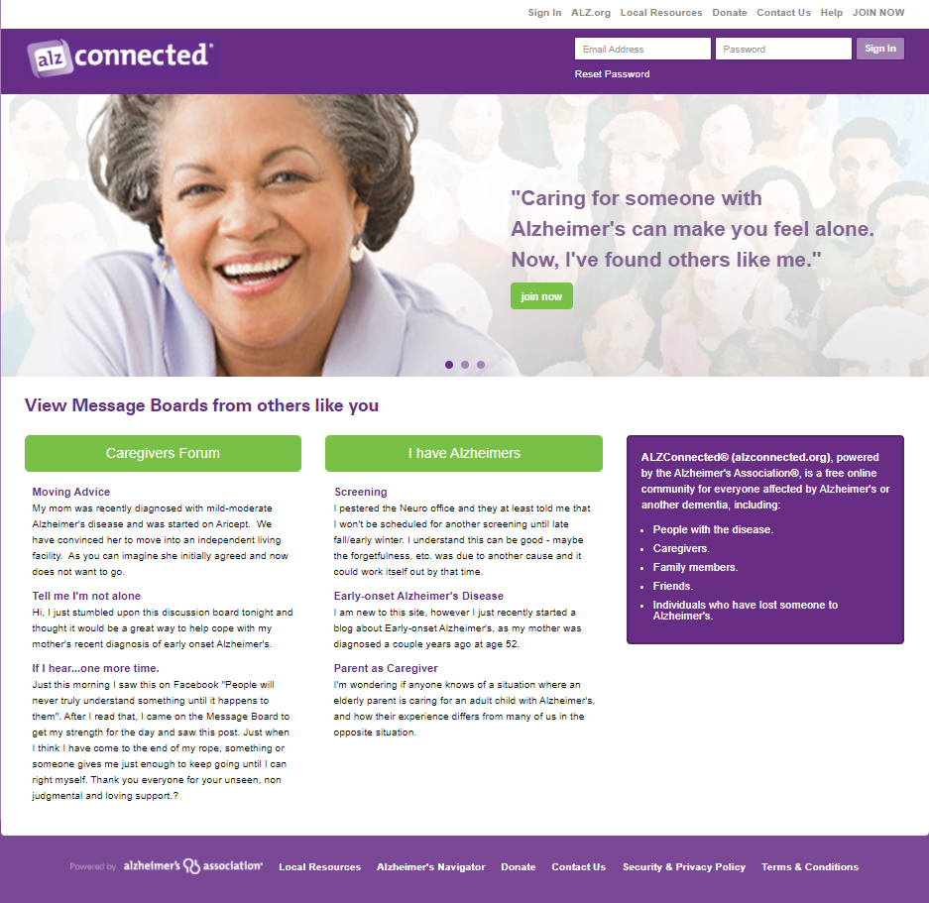
ALZConnected
Message Board
Caregivers
Persons with dementia
50,000+ Members
Share thoughts, questions, ideas with others

Slide 3
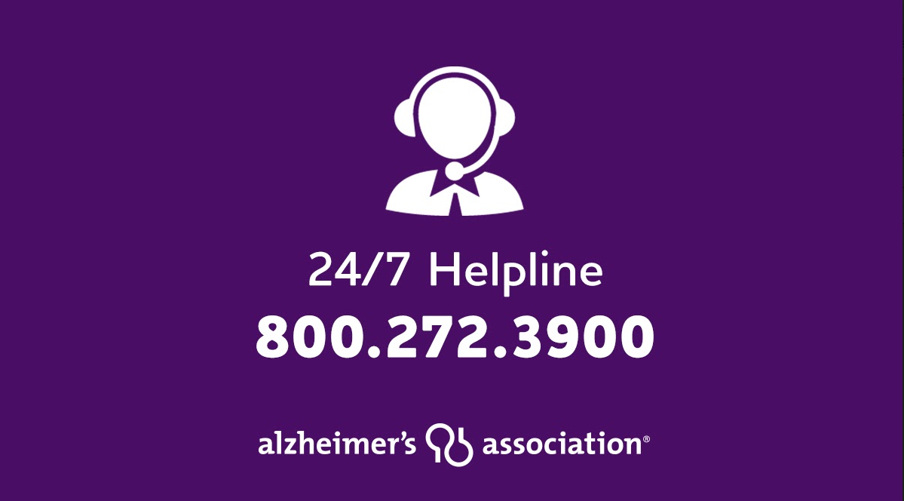
24/7 Helpline
Available around the clock, 365 days a year.
Helpline specialists and master’s-level clinicians offer confidential support and information.
Bilingual staff and translation service in 200+ languages
Live chat available.
TTY Service 866.403.3073

Slide 4
Early Stage Services
MCI (mild cognitive impairment)
Early stage dementia
Persons with dementia
Care Partners
Pre-screening required
Usually no pre-screening for Care Partners
Virtual or Phone participation only
Small group format
Notes:
Care Partners can be ANYONE who provides care and support to the individual – family, friends
PWD can participate without Care Partner, and vice-versa, in most circumstances

Slide 5
Early Stage Support Groups
8 week group
Persons with dementia and Care Partners meet separately
Early Stage Social Engagement
Focus on physical, emotional and social health
Schedule: last Tuesday of the month, 10:30 am – 11:30 am
September – Virtual program presented by Lincoln Park Zoo

Slide 6
Younger Onset Services
Under age 65
Low attendance pre-Covid
MCI (mild cognitive impairment)
All Stages
For person with dementia and care partner
Pre-screening required for PWD
Virtual or Phone participation only
Education programs and specialized Support Groups
Notes:
Specialty Support groups include:
Younger Onset Caregivers
Young Adult Children of People with Younger Onset

Slide 7
Community Education Programs
Virtual
Live Q&A
Virtual environment has allowed offering of specialized programs such as LWA series
“Bonus Content” and special events
Family Conference on November 13; includes education, guest speakers, healthy cooking demonstration, chair yoga
New: Watch Parties – 5 scheduled in 2022
Notes:
LWA Series: Early Stage 3-part education program on Wednesdays in December – 8th, 15th, 22nd – flyer in the works – separate sessions for PWD (morning 10 – 11:30) and Care Partners (12:30 – 2). Requires pre-screening for PWD; no requirement for both PWD and Care Partner to attend.
Watch Parties can be set up by organizations through us – allows the organization to host the event virtually for in-person viewers who would otherwise not have a way to view it – ex: Senior Centers, living communities, churches, etc
Watch Party info:
1) January 20th at 12pm – Healthy Living and the State of the Planet with Mission Wildlife
2) March 31st at 12pm – Advancing the Science
3) May 5th at 12pm – Healthy Living with a class on the Monarch Butterfly and class to build your own Butterfly Garden with Klehm Gardens
4) June 30th at 12pm Healthy Living with a Chef to make “Delectable Treats for your 4th of July Party”
5) October (TBD) – Effective Communication Strategies & Fall Activities for Family Members and Friends with Dementia (SIU/Alzheimer’s Center)

Slide 8
Caregiver Support Groups
Volunteer-led
Meet by phone, virtually or in-person
Other Support Given by Facilitators:
- check-in calls,
- music by phone
- contactless drop off of small items

Slide 9
Other Activities and new Ideas
Weekly Newsletter – links to virtual events, games, puzzles, fun videos, music
American Greetings E-cards - $20 for a one year subscription – have musical and customizable cards!
Miller Senior Center/Alisha Dault in Pekin: radio broadcast programs in parking during Daily Bread, parking lot bingo, and drive-in movies

Slide 10
Contact Information:
Elizabeth Hagemann,
Senior Manager Education & Community Volunteers
ehagemann@alz.org

